Slide 1
Designing Your Robot
Kevin Nufer
24 Apr 2017

Slide 2
What do you want to do?
Raise the voltage
Option 1: Boost Converter
Option 2: Get a battery with a higher voltage and use an H-bridge or a transistor
Lower the voltage
Option 1: Buck converter (UBEC)
Option 2: Use a linear regulator (there is a small one on your Arduino, but it can’t handle large amounts of current)

Slide 3
What do you want to do, cont.?
Use a servo
Requires an input of 5V
Use a buck converter on your 7.4V battery source
[what type of pin on Arduino?]
Electromagnet
Requires an input of 12V
Use a boost converter on your 7.4V battery source
H-Bridge (or a transistor/relay)
Stepper Motor
The H-bridge driving the 28BYJ-48 model purchased requires 5-12 V input
Voltage input needs to be directly from the battery (or at least not through the Arduino)

Slide 4
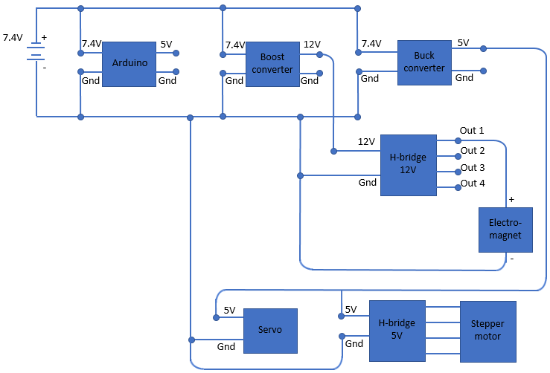
Subsystem example
To the right is an electrical diagram of a subsystem with an electromagnet, servo, and stepper motor
Not shown: the rest of the robot (the rest is tied in to the Arduino too)

Slide 5
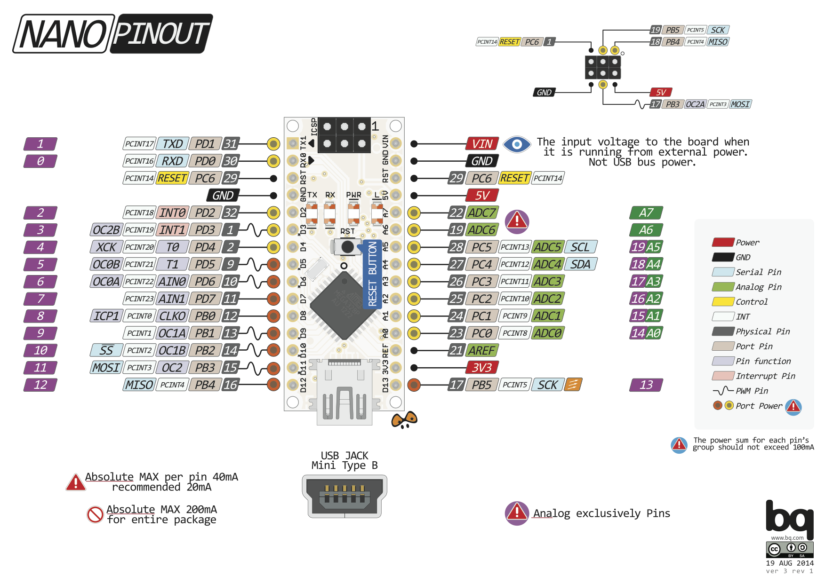
The purple numbers are how the Arduino IDE references them
http://www.pighixxx.com/test/wp-content/uploads/2014/11/nano.png

Slide 6
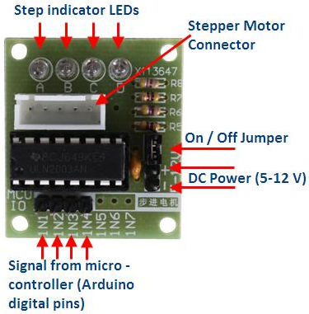
Connecting the Stepper Motor H-bridge to the Arduino
Connect the ULN2003 driver IN1, IN2, IN3 and IN4 to digital pins D3, D4, D5 and D6 respectively on the Arduino Uno.
These pins are necessary if you are using the “AccelStepper” library (which, if you use my code, you are)
Connect the positive lead from a decent 5-12V battery pack to the “+” pin of the ULN2003 driver and the ground to the “-” pin.
Make sure that the “on/off” jumper next to the “-” pin is on
If you power the Arduino from a different battery pack, connect the grounds together.

Slide 7
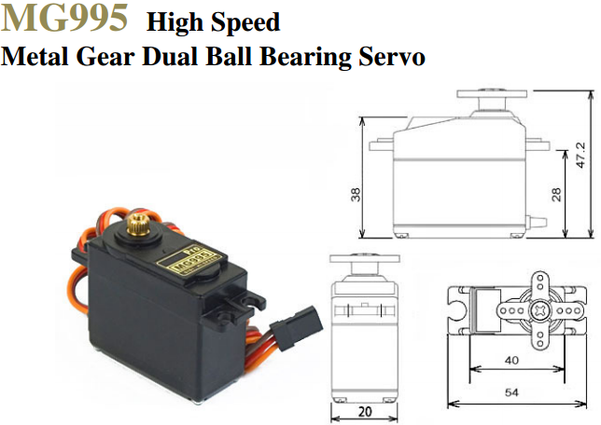

Servo
http://www.electronicoscaldas.com/datasheet/MG995_Tower-Pro.pdf
Specs
Stall torque: 8.5 kgf·cm (4.8 V ), 10 kgf·cm (6 V)
Operating speed: 0.2 s/60º (4.8 V), 0.16 s/60º (6 V)
Operating voltage: 4.8 V a 7.2 V
Rotates 120 degrees
How to hook up:
Red wire to positive (off of buck converter)
Black wire to ground
Orange wire to a Digital Pin
See the Arduino Nano diagram on slide 5: any pin with a ‘D’ in front of it; reference it in the Arduino IDE by the purple number

Slide 8
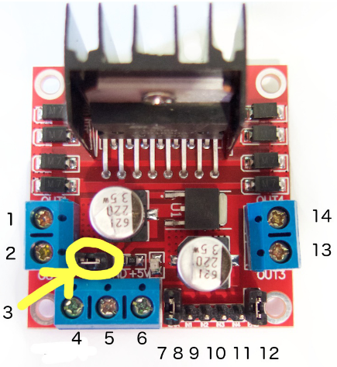
Electromagnet (using H-bridge)
(Description of how to attach the pins—electromagnet, boost converter etc)
1. DC motor 1 "+" or stepper motor A+
2. DC motor 1 "-" or stepper motor A-
3. 12V jumper - remove this if using a supply voltage greater than 12V DC. This enables power to the onboard 5V regulator
4. Connect your motor supply voltage here, maximum of 35V DC. Remove 12V jumper if >12V DC
5. GND
6. 5V output if 12V jumper in place, ideal for powering your Arduino (etc)
7. DC motor 1 enable jumper. Leave this in place when using a stepper motor. Connect to PWM output for DC motor speed control.
8. IN1
9. IN2
10. IN3
11. IN4
12. DC motor 2 enable jumper. Leave this in place when using a stepper motor. Connect to PWM output for DC motor speed control.
13. DC motor 2 "+" or stepper motor B+
14. DC motor 2 "-" or stepper motor B-
H-bridge tutorial: https://tronixlabs.com.au/news/tutorial-l298n-dual-motor-controller-module-2a-and-arduino/

Slide 9
Suggested pin selections for your subsystem
One stepper motor:
Control H-bridge using pins D3, D4, D5, and D6
First servo: D7 (can be any unused digital pin)
Second servo: D8 (can be any unused digital pin)
Electromagnet:
Extra ultrasonic rangefinders:
Second stepper motor:

